Slide 1

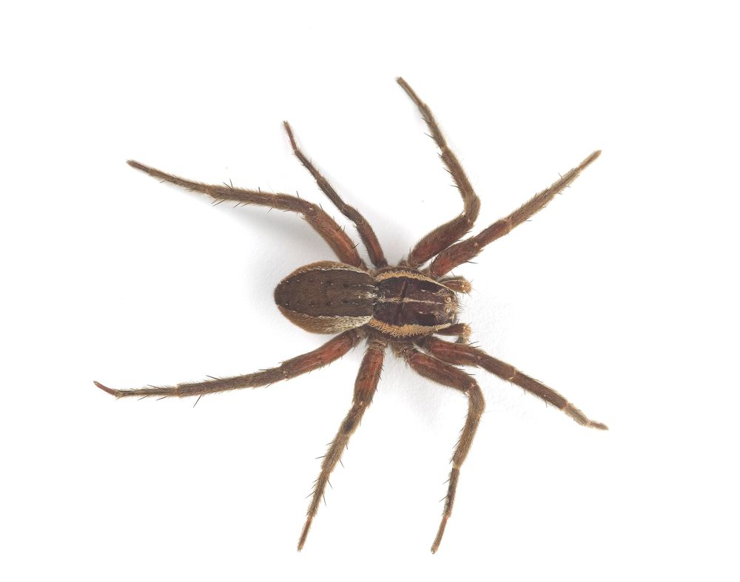
Spectacular Spiders
START

Slide 2
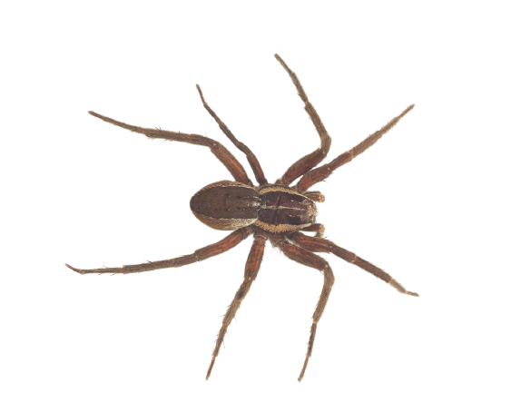
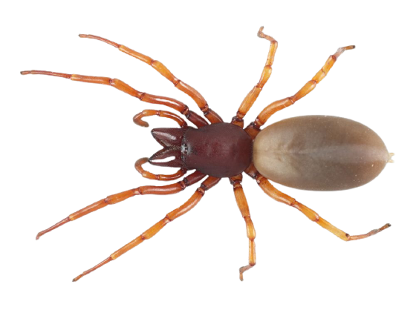
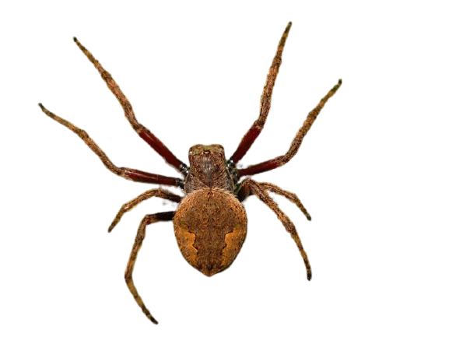
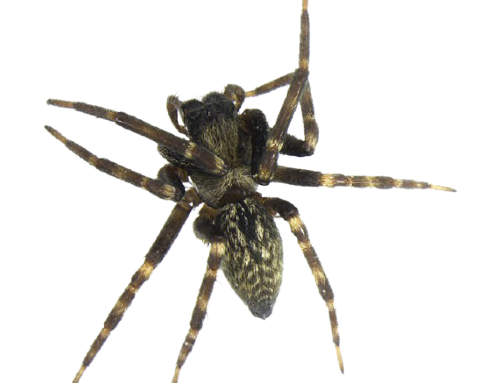
What is a spider?
How do spiders eat?
Can spiders hear?
Why do spiders make silk?
END

Slide 4
What is a spider?
Spiders are arachnids. All arachnids have eight legs and two body parts. Arachnids belong to a larger group called arthropods that also includes insects and crustaceans.
New Zealand has around 1,500 named spiders, with an estimated 2,500 different species.
Nursery web spider
Dolomedes minor
Found: Gorse
Body size: up to 18 mm
Leg span: up to 60 mm or more
Body Plan
BACK

Slide 5
Exoskeleton: The hard external skeleton
Legs: Spiders have eight jointed legs
Pedipalps: A pair of leg-like structures near the mouth for handling prey
Spinnerets: Silk spinning organs at the back of the abdomen
Cephalothorax (kef-a-lo-thor-ax): The front part containing mouth parts, the eyes and stomach
Abdomen: The rear part of the spider which contains the heart, lungs and silk glands
BACK

Slide 7
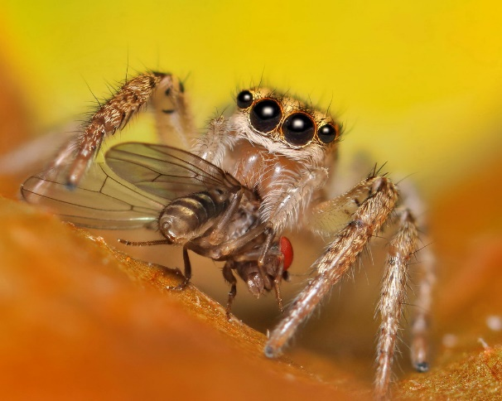
How do spiders eat?
All spiders feed on liquids and cannot eat solid food like humans. Some spiders crush the body of their prey before eating and some suck out the insides like a milkshake.
Spiders have fangs in front of their mouth that they use to inject venom to paralyse their prey before eating.
Grey house spider
Badumna longinqua
Found: Inside and outside houses. Also on car mirrors
Body size: up to 15 mm
Explore a spider’s mouth
BACK

Slide 8
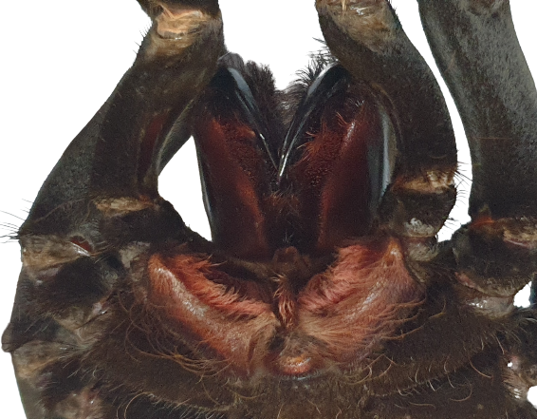
Mouth: The mouth is attached to a sucking stomach that allows the spider to slurp up its prey.
Chelicerae (Kah-li-suh-ree): These are the spider’s jaws. The fangs are hollow tubes, much like a syringe, and inject venom into their prey.
BACK

Slide 9
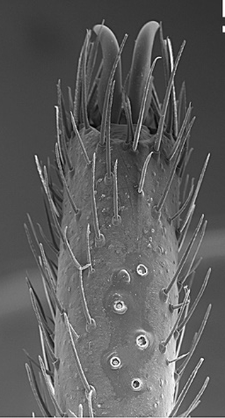
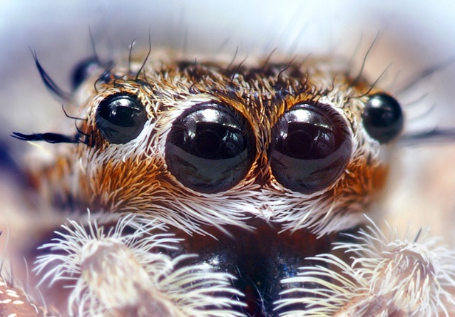
Spider Senses
Spiders can’t hear. Instead they have long hairs all over their body called setae which detect vibrations and air movement.
Most spiders have eight eyes, but have very poor eyesight. The exception are jumping spiders which have excellent eyesight and are great hunters.
Slater spider
Dysdera crocata
Found: In your garden
Body size: up to 15 mm
BACK

Slide 10
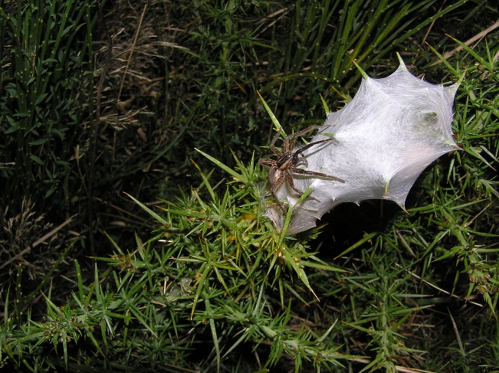
Spider Silk
Spiders produce different kinds of silk. It can be used to trap prey, to build nests and to protect their eggs. Around half of all spiders build webs to catch food.
Spider silk is the strongest natural fibre that exists. It is about five times stronger than a strand of metal the same width!
Knobbled orbweaver
Eriophora pustulosa
Found: Very common in gardens
Body size: up to 12 mm
Watch how a spider weaves its web
BACK

Slide 11

Head outside and explore your garden, local park or school grounds and see what you can find!
Use the Seek by iNaturalist app to help identify what you see. It is kid-safe.
Spectacular Spiders
Back to the start

