Slide 1
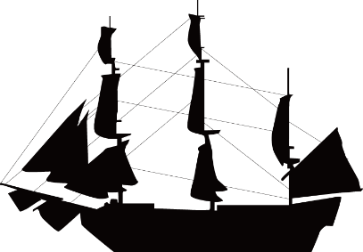
Start
Frank Worsley
Navigator and Captain
Click on the ship to learn more about the boy from Akaroa
Commander Frank Worsley, Imperial Trans-Antarctic expedition (Endurance), 1914-17. 1981.110.91
Notes:
Commander Frank Worsley (1914-17). Canterbury Museum 1981.110.91. No known copyright.

Slide 2
Menu
The boy from Akaroa
Frank Worsley’s dream
Timeline of the Imperial Trans-Antarctic Expedition
Navigating the worst ocean in the world

Slide 3
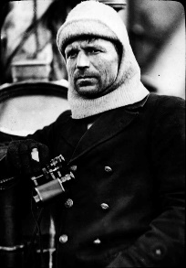
The Boy from Akaroa
Joined the New Zealand Shipping Company
Joined the Endurance as captain
Returned to the Antarctic as the navigator on Quest
1872
1901
1917
1943
1887
1914
1921
Born 22 February in Akaroa
Gained first command on Countess of Ranfurly
Served in the Royal Navy during World War One
Died 1 February in Surrey, England
BACK
Notes:
Commander Frank Worsley (1914-17). Canterbury Museum 1981.110.91. No known copyright.

Slide 4
Frank Worsley’s Dream
Frank Worsley claimed to have been attracted to the Imperial Trans-Antarctic expedition by a dream where he navigated a ship along Burlington Street in London which was full of blocks of ice.
Being superstitious, he visited the location of his dream the next day and saw a sign adverting the expedition. He met with Ernest Shackleton and was hired on the spot as Captain of the Endurance.
BACK

Slide 5
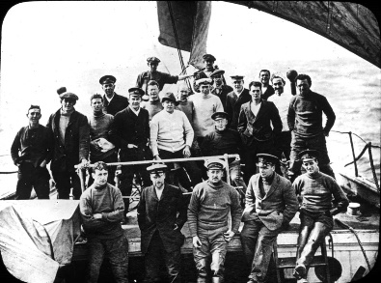
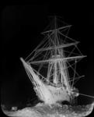
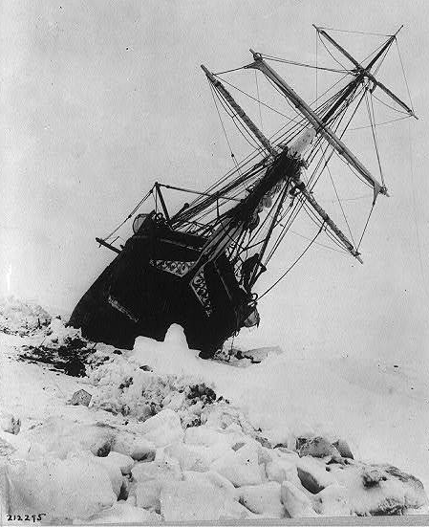
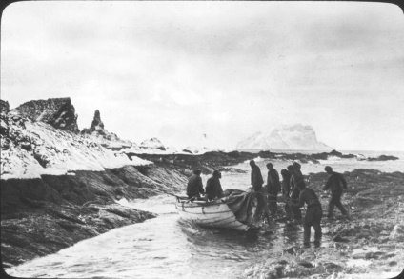
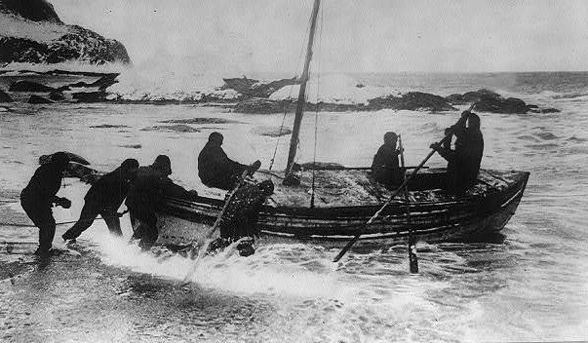
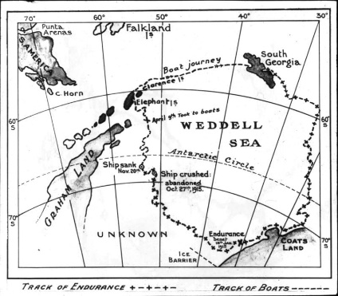
8 August 1914
19 January 1915
24 October 1915
14 April 1916
24 April 1916
9 May 1916
BACK

Slide 6
8 August 1914
Frank Worsley and the Endurance leave Plymouth, England for Antarctica. They stop at Grytviken whaling station on South Georgia Island for advice on currents and pack ice.
It will be a greater journey than the journey to the Pole and back, and I feel it is up to the British nation to accomplish this, for we have been beaten at the conquest of the North Pole and beaten at the first conquest of the South Pole. There now remains the largest and most striking of all journeys – the crossing of the Continent.
Ernest Shackleton’s argument for the expedition.
Notes:
Lansing, A. 2000. Endurance. London: Phoenix, an imprint of Orion Books Ltd; pp10-11
Expedition members on Endurance, Ernest Shackleton in middle front in white, Frank Worsley, also in white behind (1914-17). Canterbury Museum 1981.110.86. No known copyright.

Slide 7
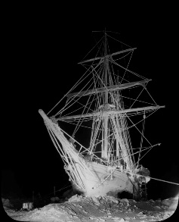
19 January 1915
The Endurance is frozen solid in the pack ice. The ship is converted into winter quarters called The Ritz.
At midnight on January 24, a crack 15 feet wide appeared about 50 yards ahead of the ship. By mid-morning the crack was a quarter of a mile across. A full head of steam was raised, all sails set, and the engines put full speed ahead in an attempt to break through the ice with all her might – and never moved a foot.
Alfred Lansing describing the attempt to break free from the pack ice.
Notes:
Lansing, A. 2000. Endurance. London: Phoenix, an imprint of Orion Books Ltd; p 30
Endurance trapped in ice, Weddell Sea, Imperial Trans-Antarctic expedition (Endurance), 1914-17 1981.110.97.
Endurance trapped in ice, Weddell sea (1914-17). Canterbury Museum 1981.110.97. No known copyright.

Slide 8
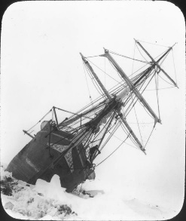
24 October 1915
Under immense pressure from the ice the ship starts to leak and the order is given to abandon ship.
The Endurance finally slips under the ice in late November.
This is not a pleasant job. We have to dig a hole down through the coals while beams and timbers groan and crack all around us like pistol shots. The darkness is almost complete and we mess about in the wet with half frozen hands.
Frank Worsley on caulking the seams of the Endurance.
Notes:
1985. Antarctica Great Stories from the Frozen Continent. Australia: Reader’s Digest Services Pty Limited, pp 220.
Endurance heeling over to port due to ice pressure, Weddell Sea (1914-17). Canterbury Museum 1981.110.104. No known copyright.

Slide 9
14 April 1916
The 28 men arrive at Elephant Island after 5 months living on the sea ice. It was the first time they had stood on land in 16 months. The men laughed with joy and celebrated with a hot drink.
If there was a mistake in my sights, which were taken under very difficult conditions, twenty-eight men would have sailed out to death. Fortunately the sights proved correct. We made the island ahead fifty hours later.
Frank Worsley on navigating to Elephant Island.
Notes:
Worsley FA. 1977. Shackleton’s Boat Journey. New York: W. W. Norton & Company Inc. p 48
Boat landing on Elephant Island (1914-17). Canterbury Museum 1981.110.64. No known copyright.

Slide 10
24 April 1916
The James Caird, captained by Frank Worsley and five other men, sets out for South Georgia Island. It is a 1,300 km journey across the most dangerous ocean in the world.
Swans of weird shape pecked at our planks, a gondola steered by a giraffe ran foul of us, which much amused a duck sitting on a crocodiles head. Just then a bear, leaning over the top of a mosque, nearly clawed at our sail… All the strange, fantastic shapes rose and fell in stately cadence with a rustling, whispering sound and hollow echoes to the thudding seas.
Frank Worsley describing icebergs while sailing to South Georgia.
Notes:
Worsley FA. 1977. Shackleton’s Boat Journey. New York: W. W. Norton & Company Inc. p 105
Launch of the James Caird from the shore of Elephant Island. No known copyright.

Slide 11
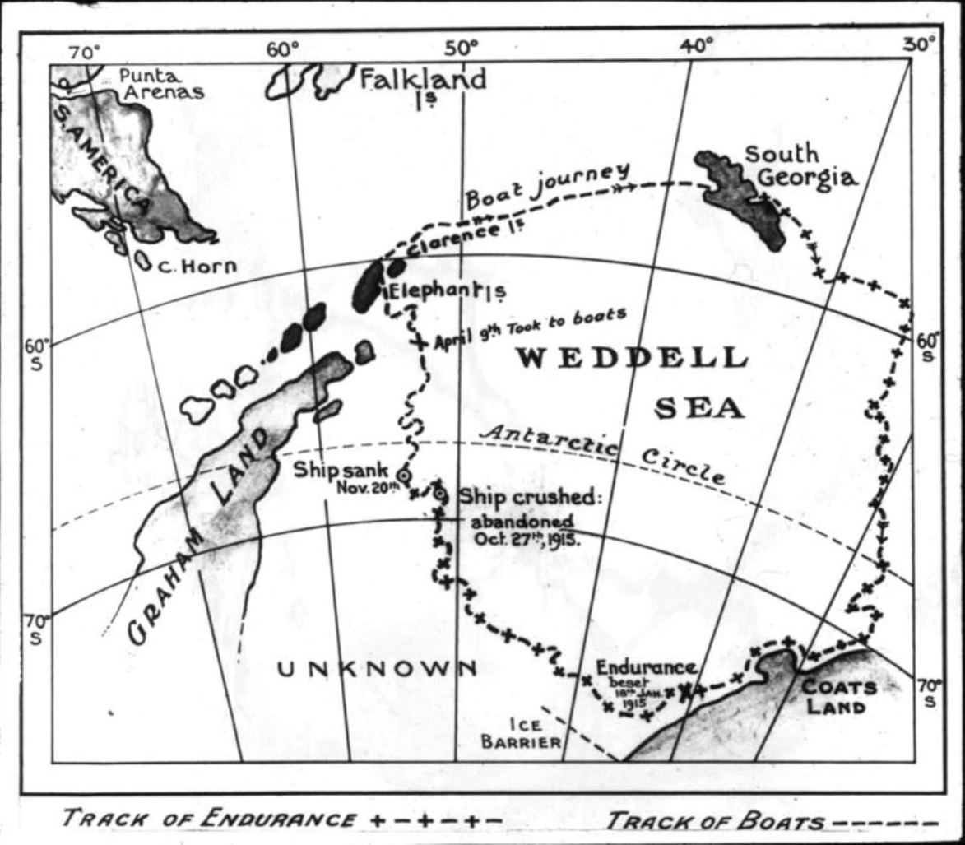
9 May 1916
After a harrowing journey Frank Worsley successfully navigates the way to South Georgia. Ten days later, Worsley and two others make a 36 hour trek to Stromness Bay. It takes 4 more months to rescue the other 22 men.
Sir Ernest asked me for the time. It was 6.55. He said: ‘We’ll listen for the whaling station’s whistle.’ Sure enough at seven, through the still morning air came the welcome sound of the turn-to whistles of the whaling station – the first sound we had heard of civilization for eighteen months.
Frank Worsley on hearing the whistle of the whaling station at Stromness Bay.
Notes:
Worsley FA. 1977. Shackleton’s Boat Journey. New York: W. W. Norton & Company Inc. p 206
Map of Weddell Sea area and South Georgia with route taken by James Caird, (1914-17). Canterbury Museum 1981.110.111. No known copyright.

Slide 12
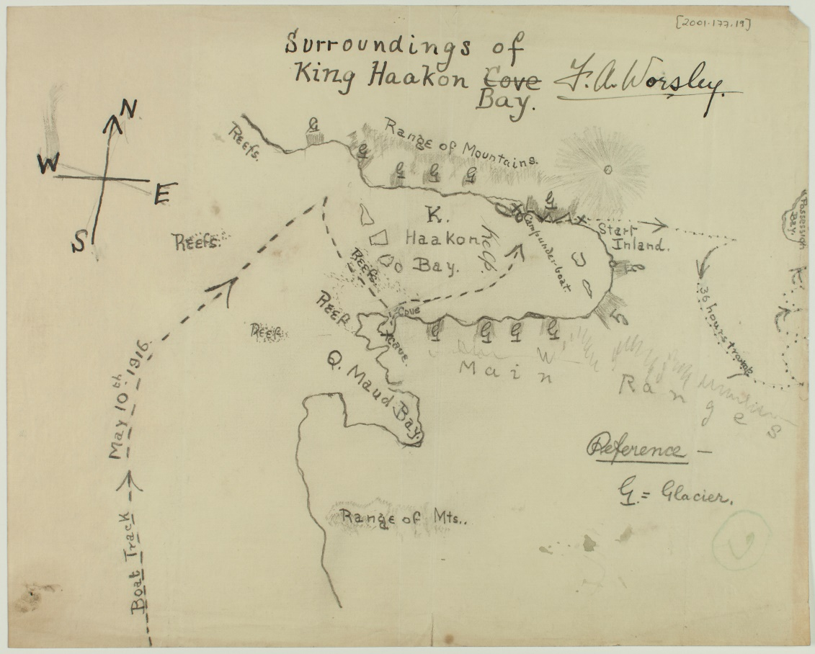
Navigating the Worst Ocean in the World
The James Caird, a 6.8-metre-long lifeboat, left Elephant Island on 24 April 1916 on a 1,300 km journey for help. Over the next 17 days the six men on board experienced howling gales, hurricanes, rotting sleeping bags and giant waves before arriving at South Georgia Island.
Frank Worsley was only able to take readings with his sextant a few times, so had to rely on dead reckoning for a good portion of their journey across the South Atlantic Ocean.
How does a sextant work?
What is dead reckoning?
BACK
Notes:
Frank Worsley’s map of King Haakon Bay , South Georgia Island. Canterbury Museum 2001.177.19. No known copyright.

Slide 13
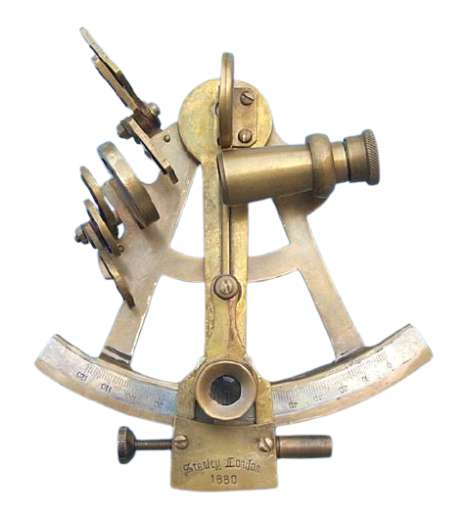
The Sextant
A sextant is an instrument used to measure the angle between the horizon and a visible object. From this angle and knowing the time of day, the latitude and longitude can be found to pinpoint a location.
I took observations of the sun for position, but the boat pitched, rolled, and jerked so heavily that I could take them only by kneeling on the after-thwart, with McCarthy and Vincent clinging to me on either side, to prevent me pitching overboard, sextant and all.
Frank Worsley on the journey to South Georgia Island.
Navigate at Sea! activity
BACK
Notes:
Worsley, FA. 1977. Shackleton’s Boat Journey. New York: W. W. Norton & Company Inc. p 116.

Slide 14
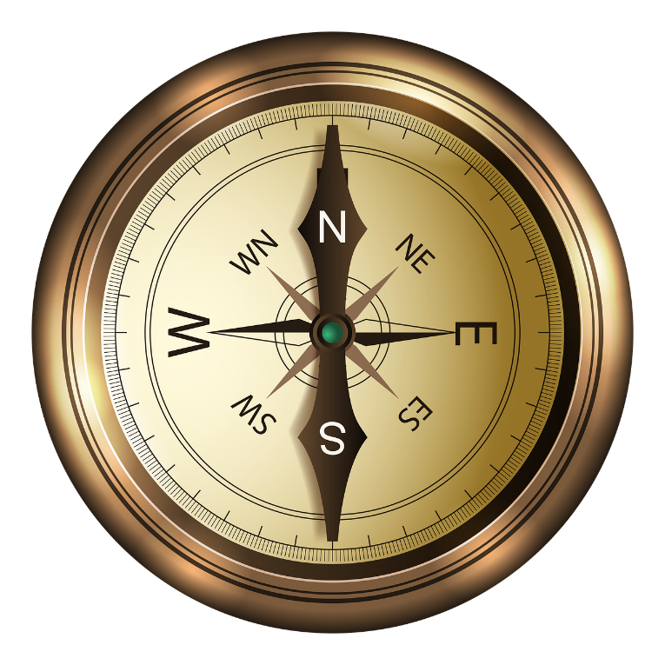
Dead Reckoning
Dead reckoning is a navigation technique that estimates a vessel’s current position.
It requires a navigator to know four things:
Your starting point
What direction you are travelling
How fast you are travelling
How long you have been travelling for.
Using these pieces of information a navigator can figure out where they are. Dead reckoning becomes more and more uncertain over time and distance.
Navigation is an art, but words fail to give my efforts a correct name. Dead reckoning or DR – the seaman’s calculation of courses and distance – had become a merry jest of guesswork.
Frank Worsley describing the difficulty of dead reckoning on the journey to South Georgia Island.
BACK
Notes:
Worsley, FA. 1977. Shackleton’s Boat Journey. New York: W. W. Norton & Company Inc. p 119.

